Slide 1
Evaluating CV
Wenwen Qu

Slide 2
列表
Visualizing Deep Networks by Optimizing with Integrated Gradients
On Human Predictions with Explanations and Predictions of Machine Learning Models: A Case Study on Deception Detection

Slide 3
Visualizing Deep Networks by Optimizing with Integrated Gradients
Zhongang Qi, Saeed Khorram, Li Fuxin
Oregon State University，Tencent

Slide 4
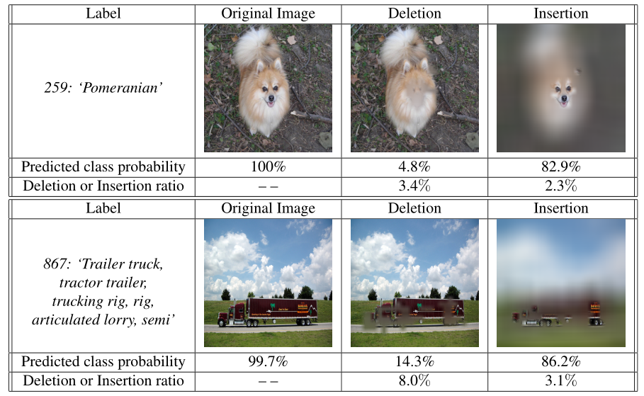
How AI Understanding Pictures
Notes:
随着深度学习的进展，对深度神经网络这种黑箱分类器进行解释变得越来越重要。人们希望了解，深度网络（究竟是用什么特征分类的？究竟是物体的核心特征，还是仅仅看了一些无关紧要的部分？在深度网络分类错误时，如著名的Tesla佛罗里达撞车事故，自动驾驶将前方的卡车识别成天空时，它们究竟使用了什么样的特征？有什么方法可以“debug”深度神经网络，看一看它们做出分类的依据是否符合人类的直观想象？

Slide 5
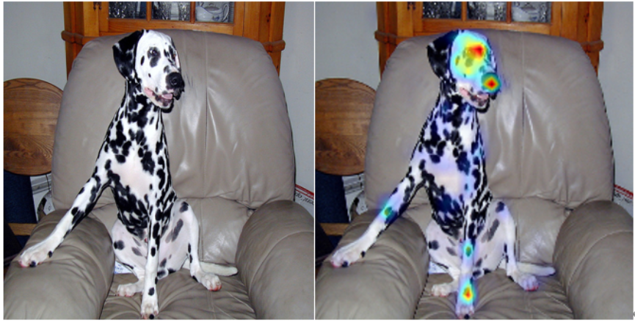
Heatmap
标识输入图像中的哪些部分对于深度神经网络的输出影响最大
Notes:
在计算机视觉中，我们可以通过计算heatmap对深度神经网络的预测分类结果进行可视化解释。来自俄勒冈州立大学机器人技术与智能系统研究所（CoRIS）和腾讯PCG应用研究中心（ARC）的研究者提出了一种基于积分梯度优化的深度神经网络可视化方法IGOS，用来计算heatmap。Heatmap标出了输入图像中的哪些部分对于深度神经网络的输出影响最大，如图1所示，深度神经网络对于原图的分类结果是‘dalmatian’ (斑点狗)，通过利用IGOS计算出heatmap我们可以看出深度网络做分类的依据是什么。显然，原图的狗的面部和腿部是模型做出‘dalmatian’分类的最重要的部分。

Slide 6
Related Works
One-step backpropagation-based visualizations
Backpropagate gradient to input space
GBP[1]、DeconvNet[2]、Saliency Maps[3]
Essentially doing (partial) image recovery
Only reflect infinitesimal changes
Springenberg, J.; Dosovitskiy, A.; Brox,T.; and Riedmiller, M. 2015. Striving for simplicity: The all convolutional net. In ICLR Workshop
Zeiler, M. D., and Fergus, R. 2014. Visualizing and understanding convolutional networks. In Fleet, D.;Pajdla, T.; Schiele, B.; and Tuytelaars, T., eds., Computer Vision
Simonyan, K.; Vedaldi, A.; and Zisserman, A. 2014. Deep inside convolutional networks: Visualising image classification models and saliency maps. ICLR Workshop
Notes:
把梯度后向传播到输入图像

Slide 7
Related Works
Perturbation-based approaches
Optimization problem: find the smallest and smoothest area that maximally decrease the output of a neural network
Mask Model, RISE
Takes a long time to converge
Stuck in a bad local optimum
Dabkowski, P., and Gal, Y. 2017. Real time image saliency for black box classifiers. In NIPS.
Petsiuk, V.; Das, A.; and Saenko, K. 2018. RISE: Randomized Input Sampling for Explanation of Black-box Models.
Notes:
把梯度后向传播到输入图像

Slide 8
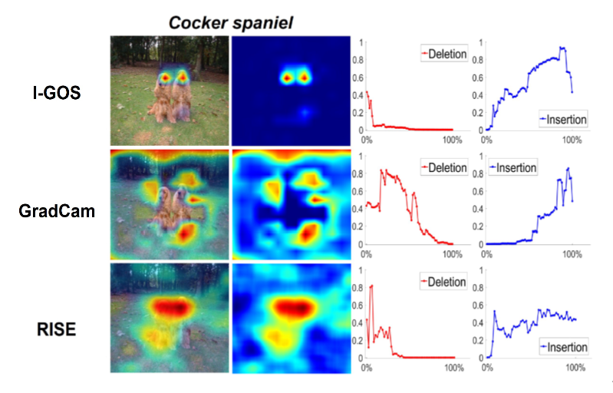
Drawbacks

Slide 9
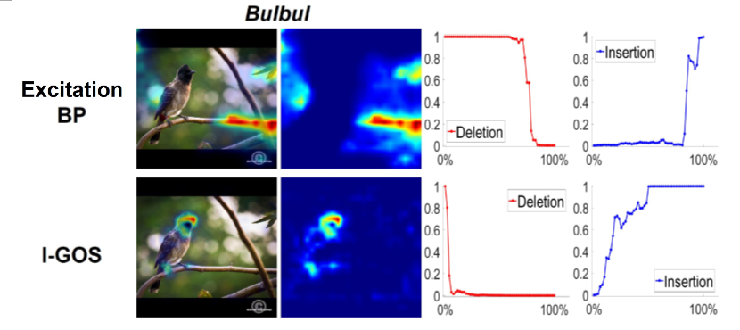
Drawbacks

Slide 10
IGOS
Integrated-Gradients Optimized Saliency
Optimize a mask using the integrated gradients
Add Noise to avoided generating adversarial masks

Slide 11
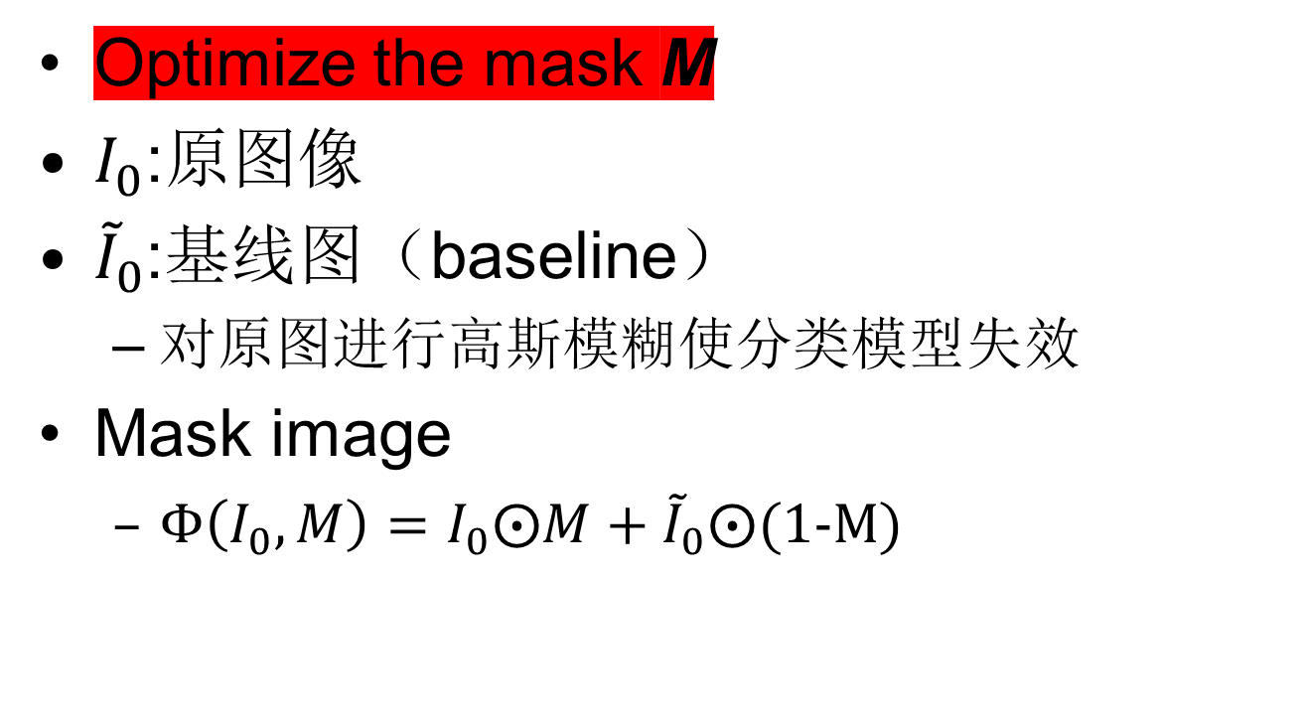
IGOS
Optimize the mask M
$I_{0}$:原图像
${\tilde{I}}_{0}$:基线图（baseline）
对原图进行高斯模糊使分类模型失效
Mask image
$Φ\left(I_{0},M\right)=I_{0}⨀M+{\tilde{I}}_{0}⨀\text{(1−}\text{M}\text{)}$

Slide 12
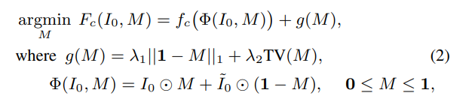
IGOS
Optimize the mask M
目标函数
模型在类别C上的输出值，
mask之后的图像得分尽可能低
平滑项，使得抹除的
区域越平滑越好
L1范数，使得mask的区域越少越好

Slide 13
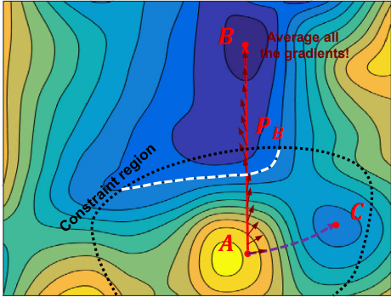
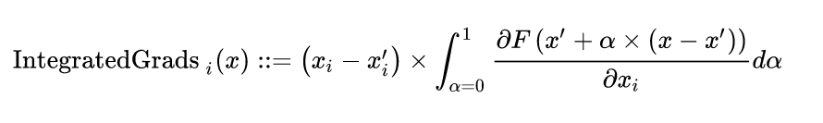
Integrated gradients
Attribution of i-th feature: the path integral from the baseline to the input image
Lead to global optima
Generate diffuse heatmaps
Notes:
优点：求解过程更快，避免陷入局部最优解
缺点：如果baseline和input在某一特征上不同，但却具有不同的输出，那么这一特征应具有非零的归因。Gradients方法违反了这一性质

Slide 14
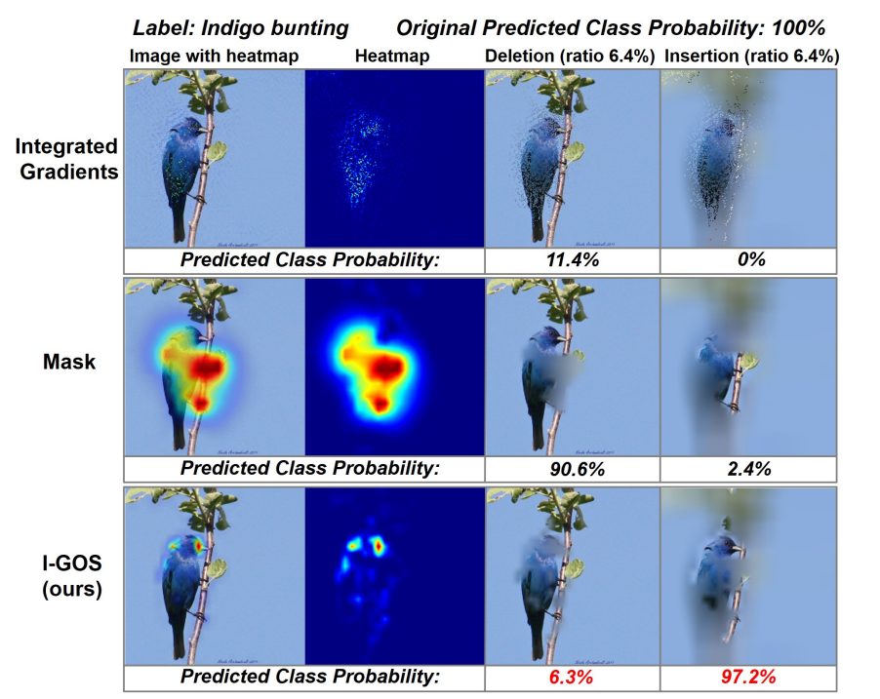
IGOS使用梯度积分优化目标函数

Slide 15
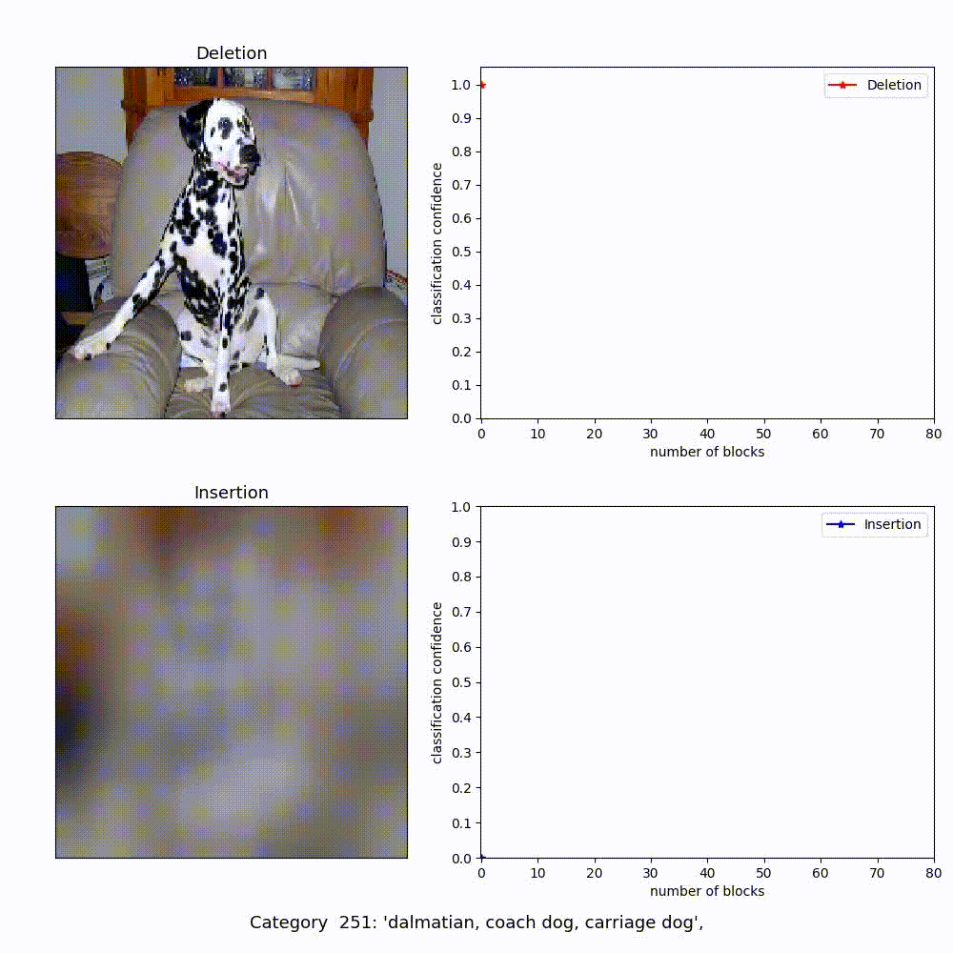

Slide 16
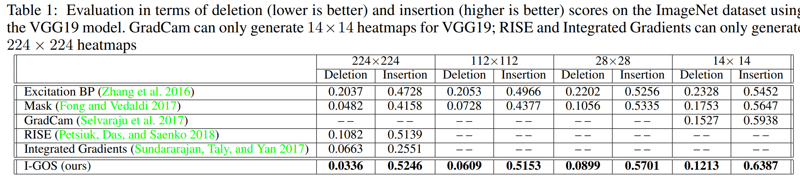
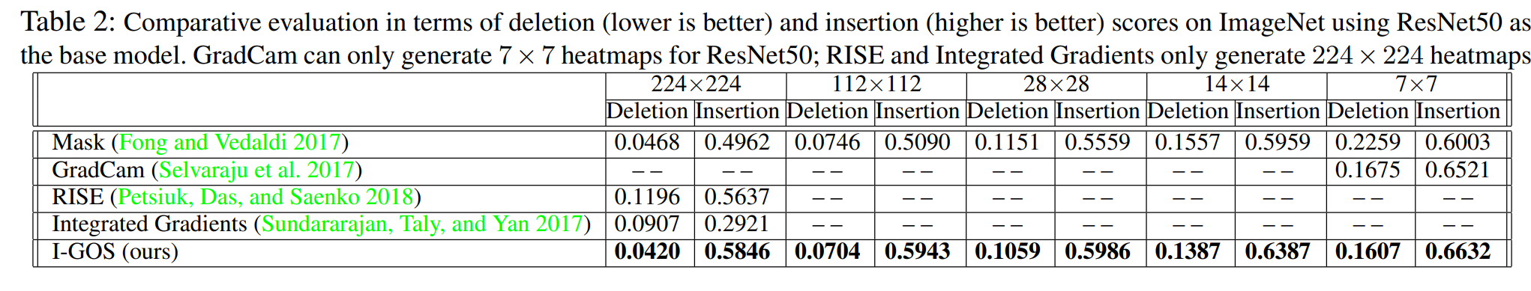
Experiments

Slide 17
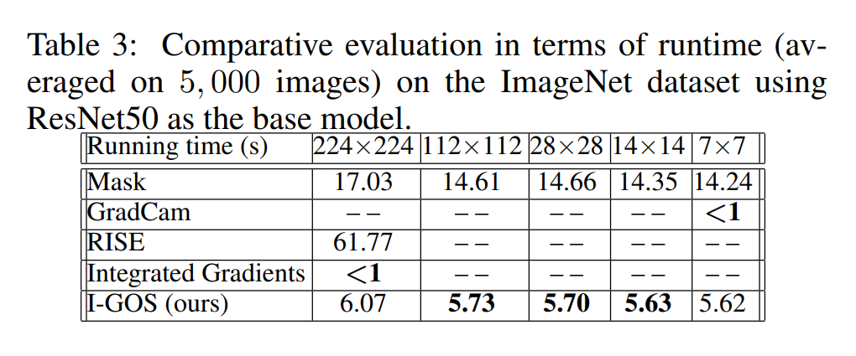
Experiments

Slide 18
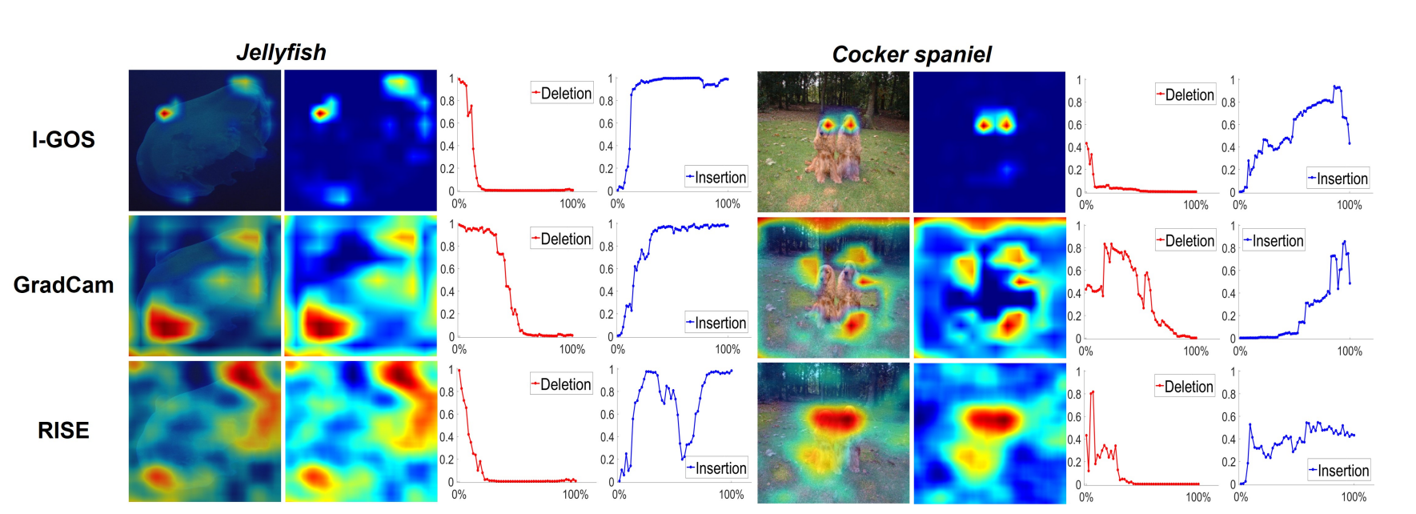
Experiments

Slide 19
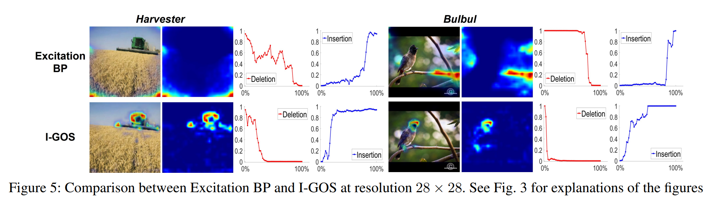
Experiments

Slide 20
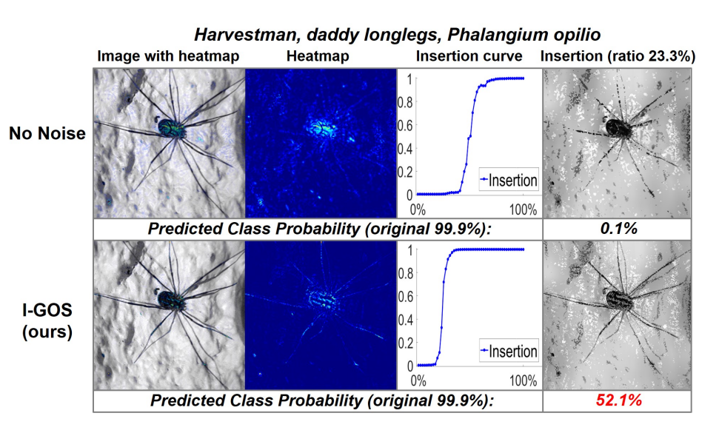
Ablation Studies

Slide 21
CONCLUDING
Integrated gradients provides a better direction
heatmaps generated by IGOS are more correlated to the decision-making of the model.

Slide 22
On Human Predictions with Explanations and Predictions of Machine Learning Models: A Case Study on Deception Detection
Vivian Lai, Chenhao Tan

Slide 23
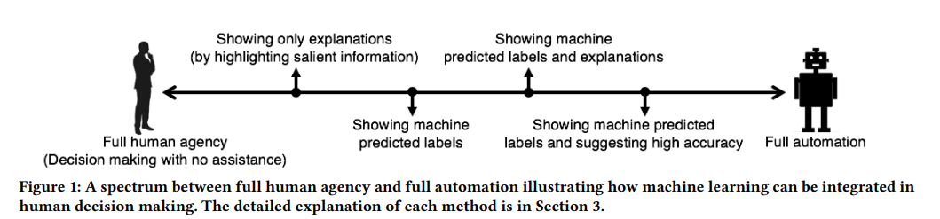
Deception detection

Slide 24
Case Study
Training Model
Dataset
800 genuine(TripAdvisor)/800 deceptive(turkers) hotel reviews
Linear SVM (87% accuracy)
80% training data / 20% test data
Myle Ott, Yejin Choi, Claire Cardie, and Jeffrey T Hancock. 2011. Finding deceptive opinion spam by any stretch of the imagination In Proceedings of ACL.

Slide 25
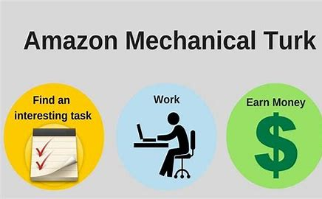
Set Up
Goal: evaluate human performance with assistance from machine learning models.
Six Levels:
Control
Feature-based explanations
Example-based explanations
Predicted label without accuracy
Predicted label with accuracy
Combinations

Slide 26
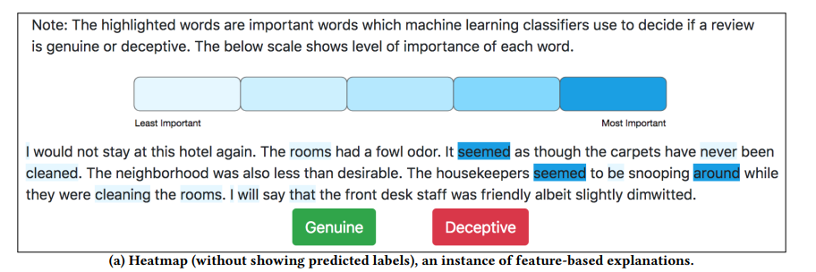
Set Up

Slide 27
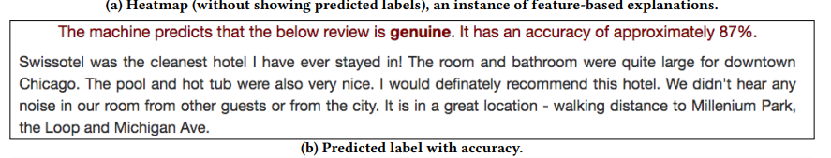
Set Up

Slide 28
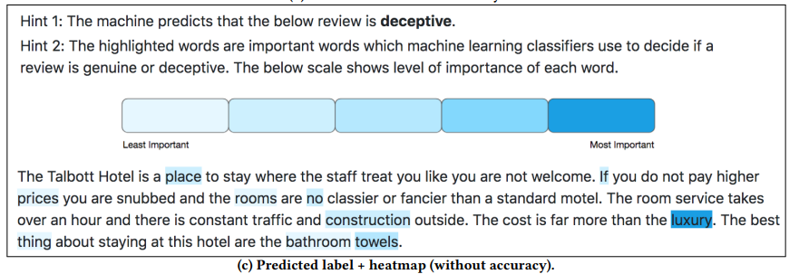
Set Up

Slide 29
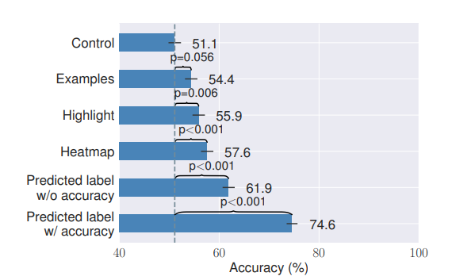
Human Accuracy
Explanations alone slightly improve human performance
showing predicted labels significantly improves human performance
Notes:
靠人类去理解解释是困难的
展示标签可能会导致人类过度依赖机器

Slide 30
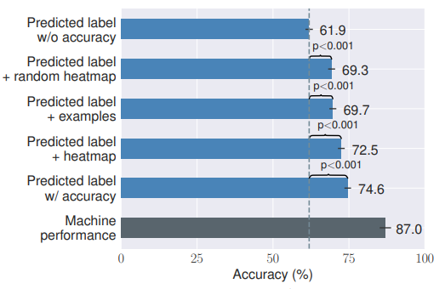
Human Accuracy
Show label + explanations
Improve human performance
Notes:
靠人类去理解解释是困难的
展示标签可能会导致人类过度依赖机器

Slide 31
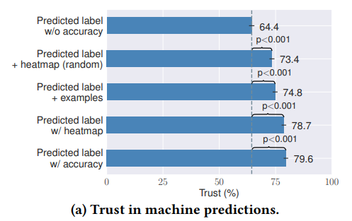
Trust
Feature (example)-based explanations increase the trust
Random heatmap can also increase the trust
Notes:
靠人类去理解解释是困难的
展示标签可能会导致人类过度依赖机器

Slide 32
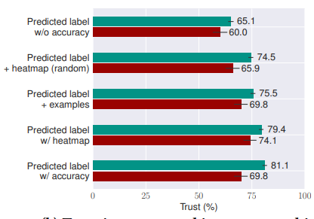
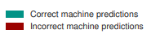
Trust
trust machine predictions more when machine predictions are correct
significantly
Notes:
靠人类去理解解释是困难的
展示标签可能会导致人类过度依赖机器

Slide 33
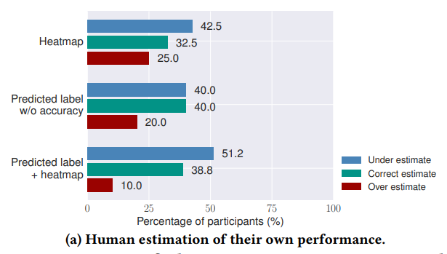
Heterogeneity
difficult for humans to estimate their performance.

Slide 34
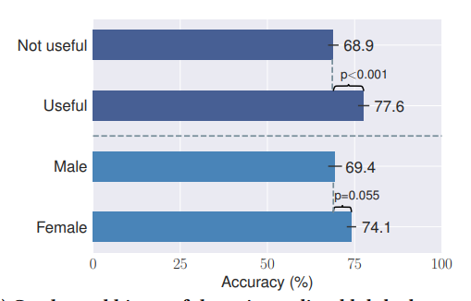
Heterogeneity
the hints useful outperform those not useful
Females generally outperform males (not significantly)

Slide 35
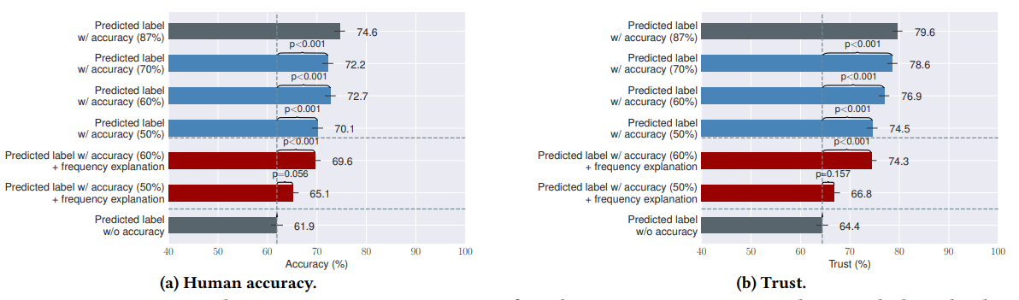
VARYING ACCURACY
Human accuracy and trust generally decline with the decrease of accuracy
Accuracy improve human trust (even 50%)

Slide 36
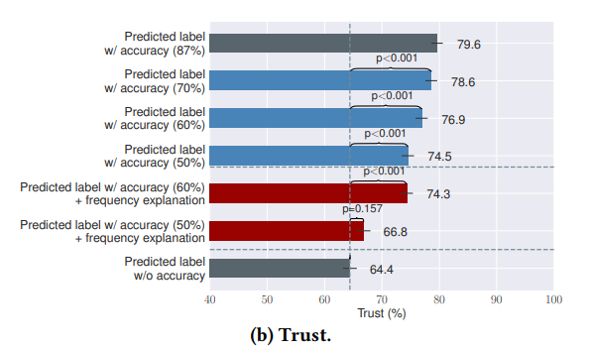
VARYING ACCURACY
Frequency explanations can help humans interpret
“The machine predicts that the below review is deceptive. It has an accuracy of approximately 50%”
“The machine predicts that the below review is deceptive. It has an accuracy of approximately 50%, which means that it is correct 5 out of 10 times.”

Slide 37
CONCLUDING
Human performance
Explanations alone slighlty improve human performance
Showing predicted labels significantly improves human performance.
Trust
Humans tend to trust correct machine predictions more than incorrect ones
But also can be fooled by machine predictions (Random heatmap…).

Slide 38
Thanks

